Slide 1
CS492 - Operating Systems Threads
Georgios Portokalidis & Jun Xu
zyBook 2.6, MOS 2.2 (except 2.2.7, 2.2.8)
Slides credit: Antonio Barbalace

Slide 2
New zyBook Assignment
5-threads
Due 2/26/2021
Chapters 2.6

Slide 3
Content
Thread Key Concepts
POSIX Threads
Threads Data Structures
Threads Implementation
Threads Switching
Making Single-thread Code Multi-thread

Slide 4
Processes (1)
A process is created to run a program to perform a duty
What if we need to perform two or more similar, or strongly related, duties?
Create multiple processes, each handling one of the duties

Slide 5
Processes (2)
Processes are not very efficient
Each process has its own PCB and OS resources
Typically high overhead, e.g., for creation
Processes don't (directly) share memory
Each process has its own address space
Process-to-process communication has overheads
Parallel and concurrent programs often want to directly manipulate the same memory
...but good for isolating (memory and other) errors

Slide 6
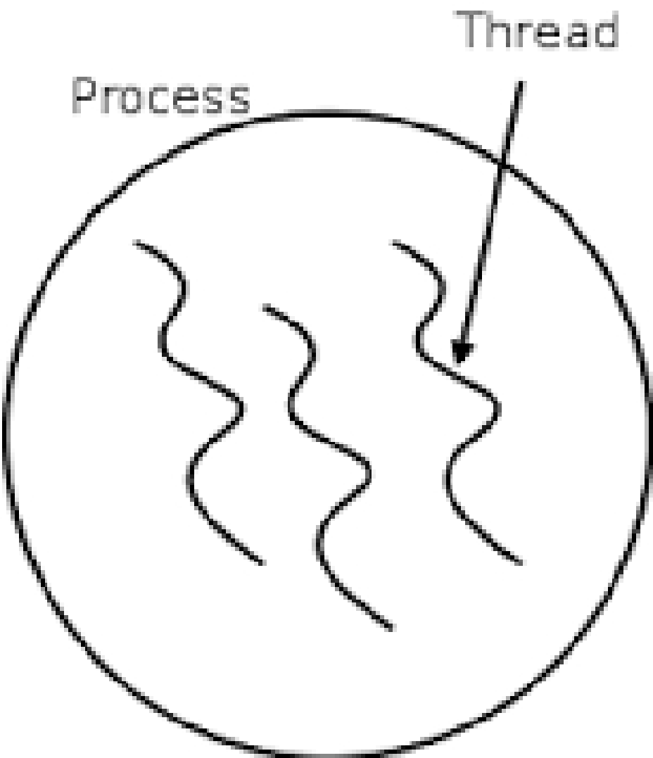
Threads and Process
A thread cannot exist without a process
A process is a “container” for threads
A process may contain one or multiple threads

Slide 7
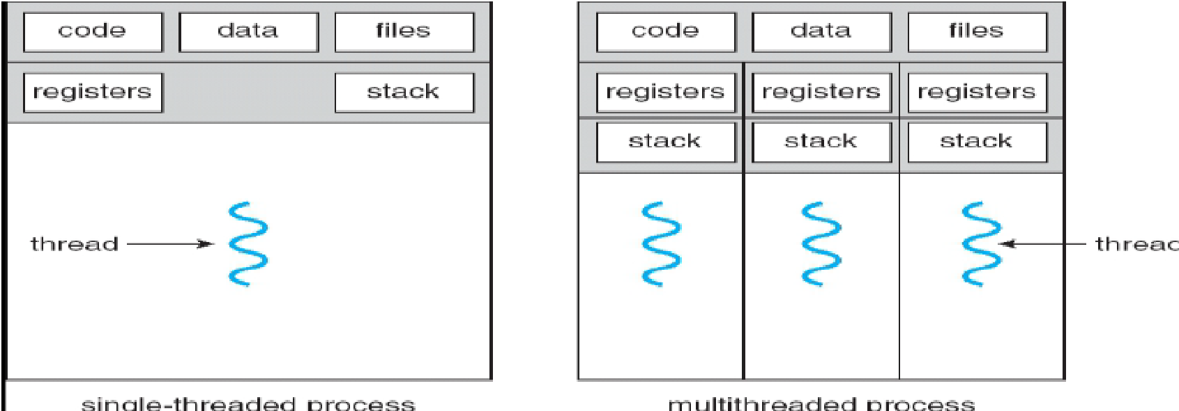
Thread vs Process
Thread is an independent sequential execution stream within a process
Programs use one or multiple threads per process

Slide 8
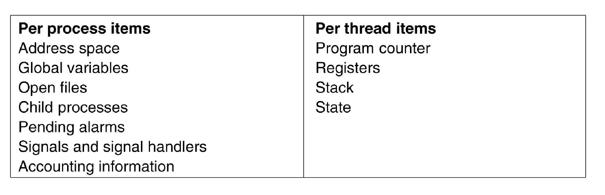
Per-Process, Per-Thread
The first column lists some items shared by all threads in a process. The second one lists some items private to each thread (MOS Figure 2-12)

Slide 9
Advantages of Threads
Performance
Share address space, no communication overhead
Thread creation is 10-100 times faster than processes
Efficiency
Allows a program to overlap I/O and computation
Allows one process to use multiple CPUs or cores
Notes:
Only now with threads we add a new element:
the ability for the parallel entities to share an address space and all of its data
among themselves. This ability is essential for certain applications, which is why
having multiple processes (with their separate address spaces) will not work.
A second argument for having threads is that since they are lighter weight than
processes, they are easier (i.e., faster) to create and destroy than processes. In
many systems, creating a thread goes 10–100 times faster than creating a process.
When the number of threads needed changes dynamically and rapidly, this property
is useful to have.
A third reason for having threads is also a performance argument. Threads
yield no performance gain when all of them are CPU bound, but when there is substantial
computing and also substantial I/O, having threads allows these activities
to overlap, thus speeding up the application.
Finally, threads are useful on systems with multiple CPUs, where real parallelism
is possible. We will come back to this issue in Chap. 8.

Slide 10
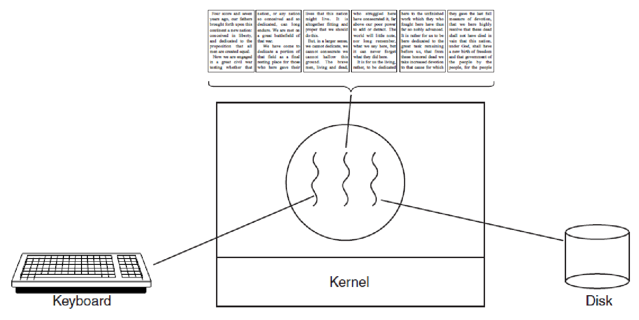
Threads Example: Word Processor
A word processor with three threads. (MOS Figure 2-7)
– One thread to read from keyboard
– One thread to format document
– One thread to write document to disk

Slide 11
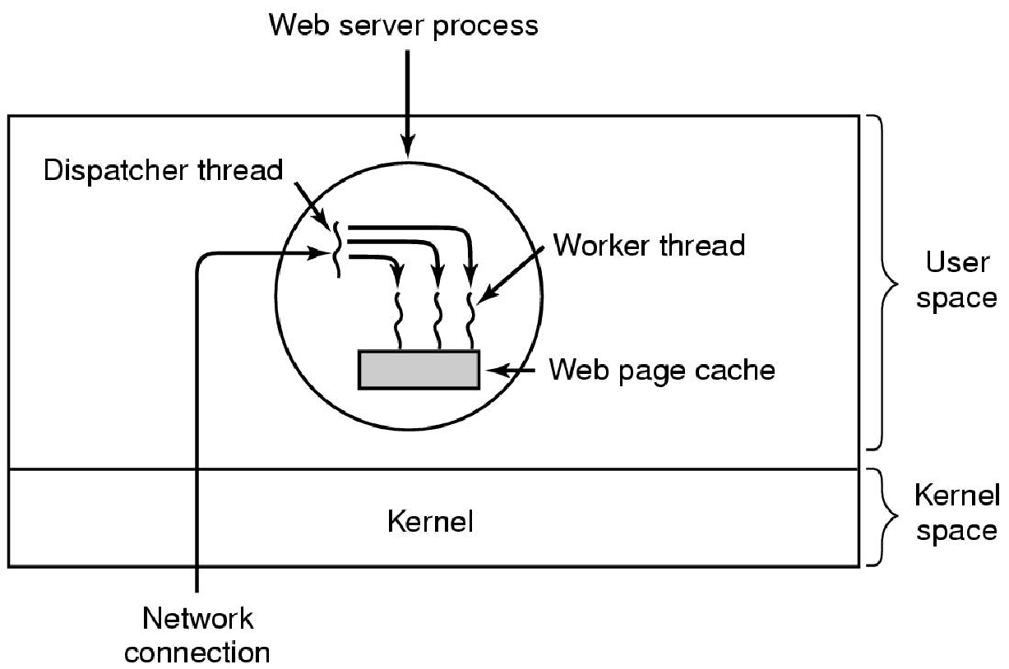
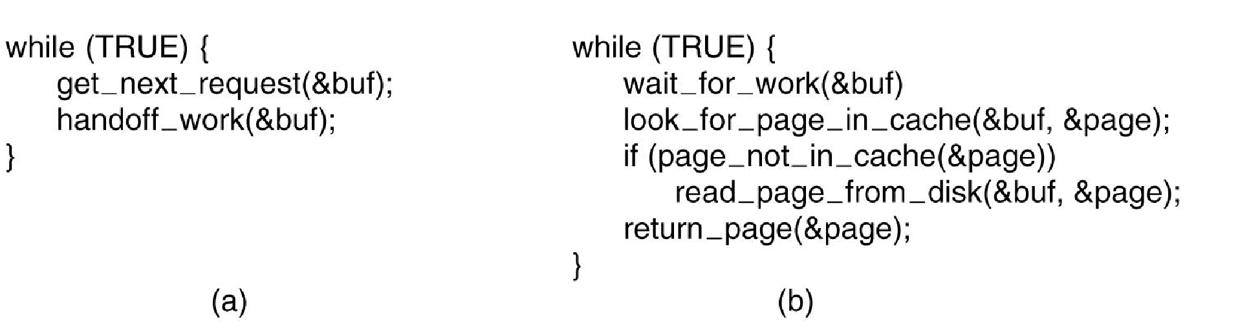
Threads Example: Web Server
A multithreaded Web server. (MOS Figure 2-8)
Outline of the Fig above. (a) Dispatcher thread. (b) Worker thread.(MOS Figure 2-9)

Slide 12
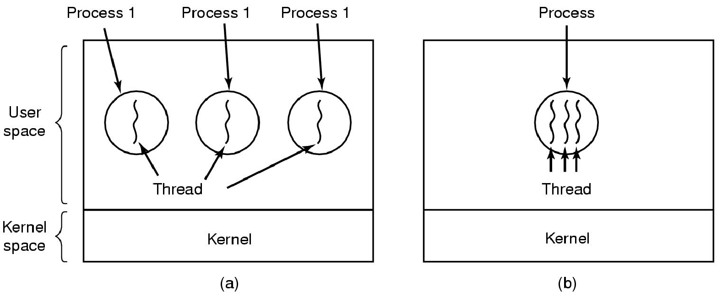
Multiprocessing vs Multithreading
Multiprocessing
Multithreading
(a) Three processes each with one thread. (b) One process with three threads. (MOS Figure 2-11)
Notes:
What threads add to the process model is to allow multiple executions to take place in the same process environment, to a large degree independent of one another.
Having multiple threads running in parallel in one process is analogous to having multiple processes running in parallel in one computer. In the former case, the threads share an address space and other resources. In the latter case, processes share physical memory, disks, printers, and other resources.
Because threads have some of the properties of processes, they are sometimes called lightweight processes.
The term multithreading is also used to describe the situation of allowing multiple threads in the same process.

Slide 13
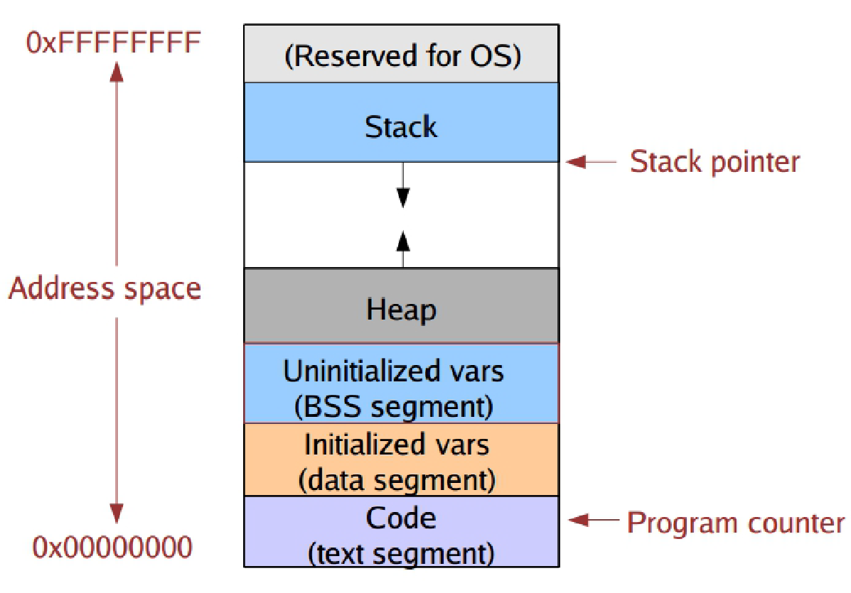
Process Address Space

Slide 14
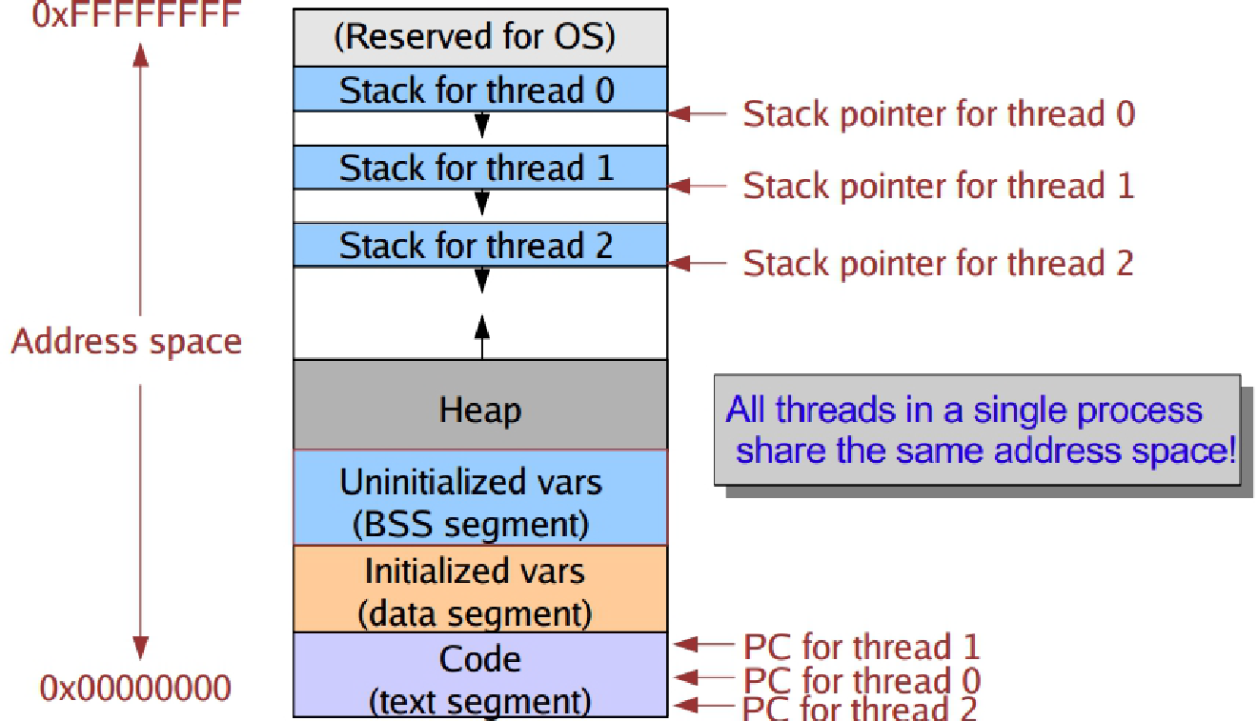
Address Space with Threads

Slide 15
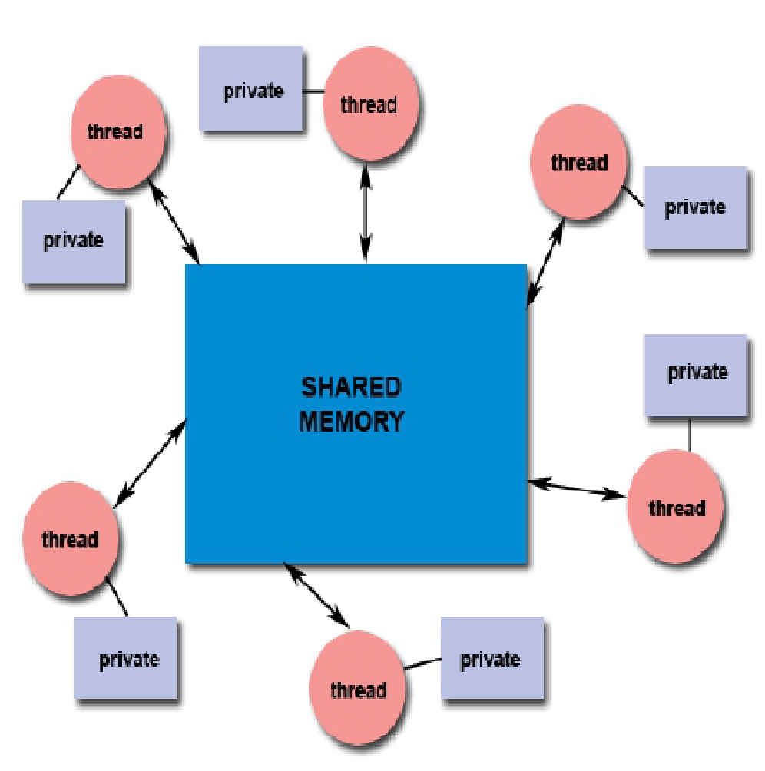
Thread Local and Global Variables
Global variable
the same for all threads
Local variable
each thread gets its own
Threads within a process share
Memory
Open files
I/O streams
File descriptors
…
(globals)

Slide 16
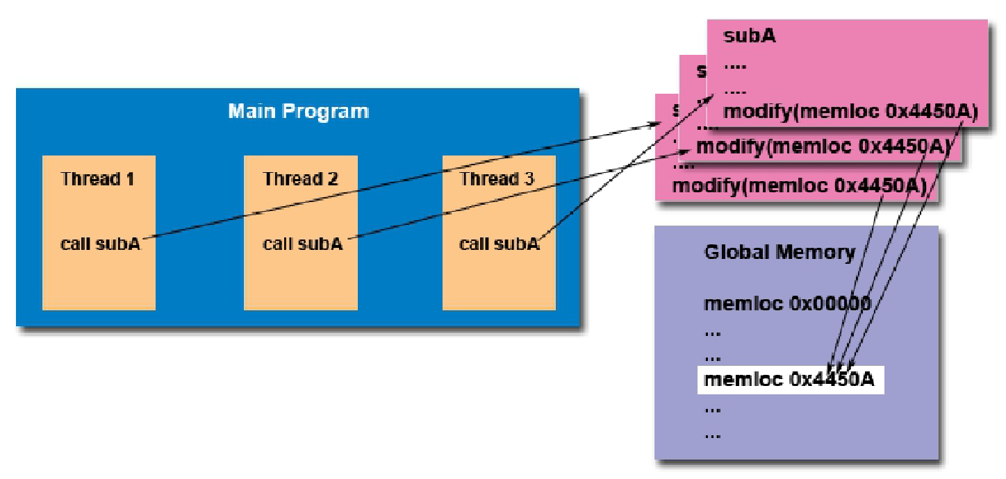
Global Variables Access (1)
Multiple threads may access the same variable concurrently
Programmers responsible to coordinate access to global (shared) variables
Synchronization
Notes:
This is about a problem with thread: sharing, how do you access concurrently to data?

Slide 17
Global Variables Access (2)
Example
Two threads, A and B, are running the same code (below)
Both threads have the same value for the variable list
Thread A just finished line 5 and Thread B is executing line 6
Thread A continues and finishes push_back()and then Thread B runs next
1: void push_back(LIST *list, int v) {
2: NODE * n = malloc(sizeof(NODE));
3: n->value = v;
4: n->next = NULL;
5: list->tail->next = n;
6: list->tail = n;
7: }
What can go wrong?
Global variable access must be coordinated!

Slide 18
Thread Dynamics
Processes start with a single thread
The first thread can create new threads
There may be a hierarchy relationship
Every thread can exit at any point
A thread may wait another thread (similar to waitpid)
A thread may yield the processor to another thread

Slide 19
POSIX Threads Threads Data Structures Threads Implementation

Slide 20
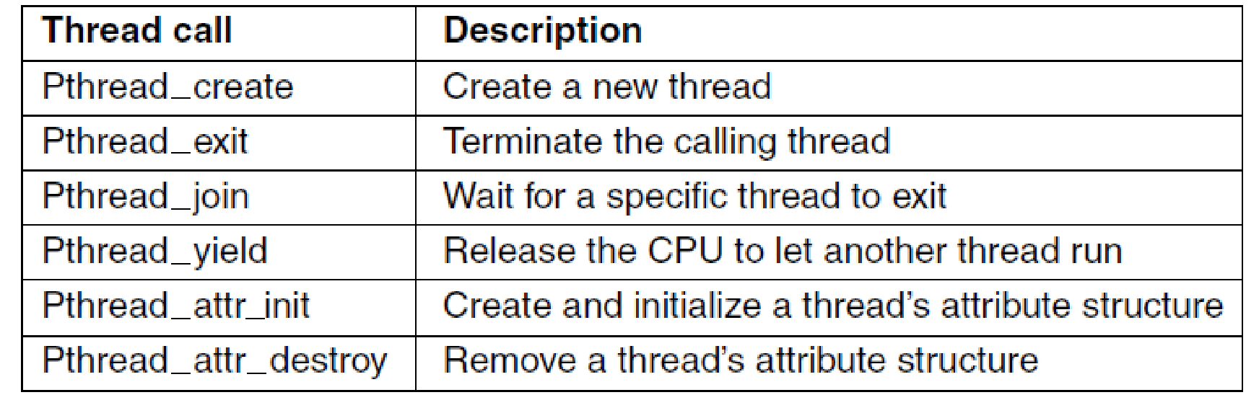
POSIX Threads (1)
Some of the Pthreads function calls. (MOS Figure 2-14)
IEEE standard 1003.1c (pthread)
Notes:
When multithreading is present, processes usually start with a single thread
present. This thread has the ability to create new threads by calling a library procedure
such as thread create. A parameter to thread create specifies the name of a
procedure for the new thread to run. It is not necessary (or even possible) to specify
anything about the new thread’s address space, since it automatically runs in the
address space of the creating thread. Sometimes threads are hierarchical, with a
parent-child relationship, but often no such relationship exists, with all threads
being equal. With or without a hierarchical relationship, the creating thread is
usually returned a thread identifier that names the new thread.

Slide 21
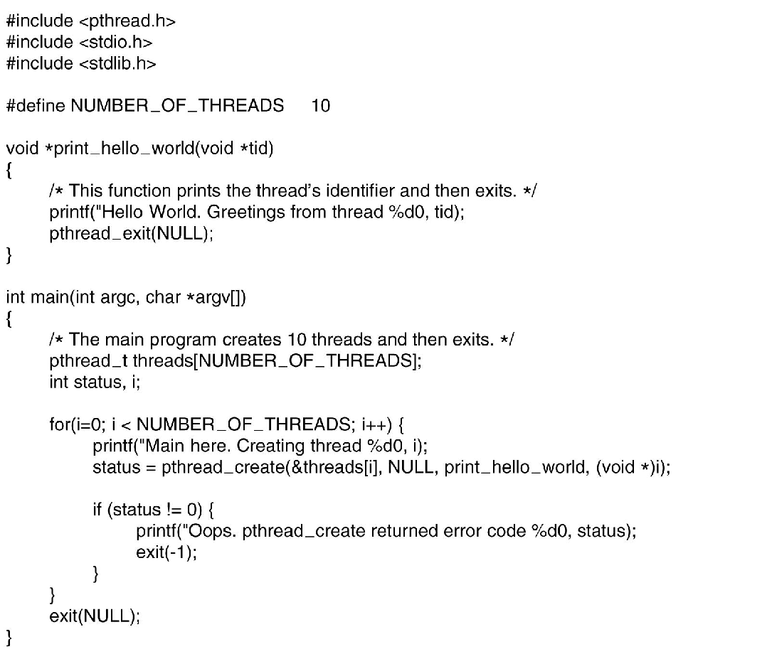
POSIX Threads (2)
Figure 2-15. An example program using threads.
Notes:
Try this code! You cannot see the existence of threads!

Slide 22
Recall: Process Table
Process Table consists of multiple entries
One entry per process (Process Control Block)

Slide 23
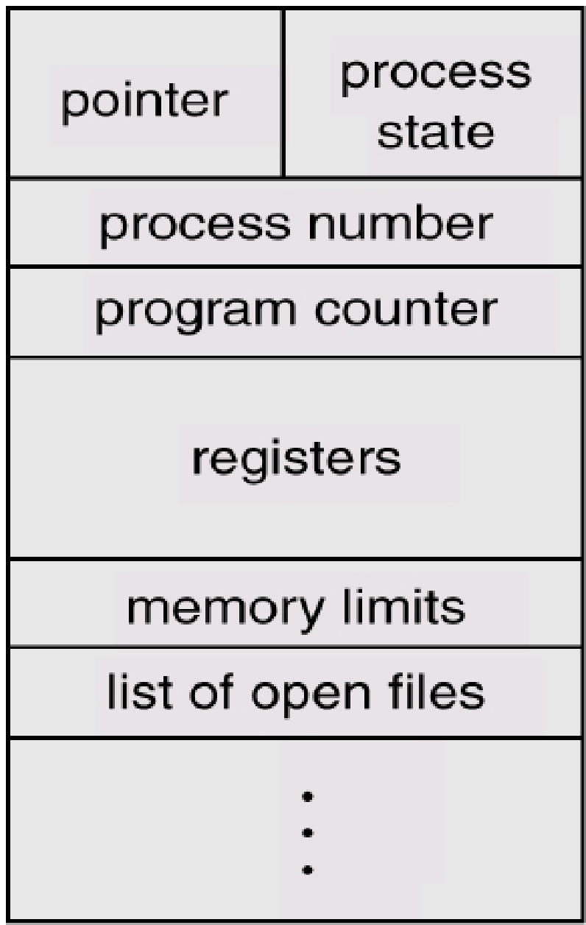
Recall: Process Control Block (PCB)
PCB contains
Process state (e.g., running)
Process ID
Program counter (PC)
Current CPU registers (if not executing)
Scheduling info (e.g., priority)
Memory-management info
Resources allocated to it
I/O status information
…

Slide 24
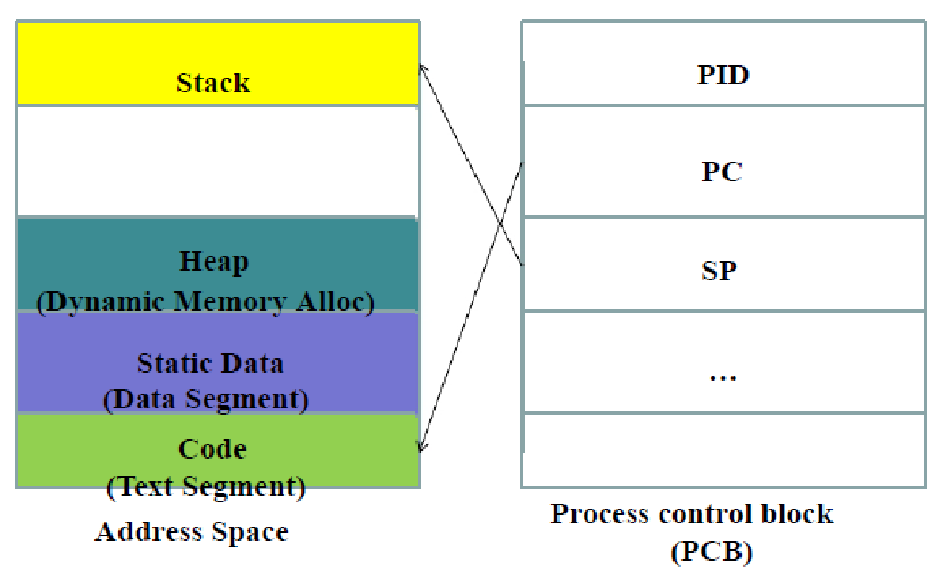
Recall: PCB Diagram

Slide 25
Thread Table
Thread Table consists of multiple entries
One entry per thread (Thread Control Block)

Slide 26
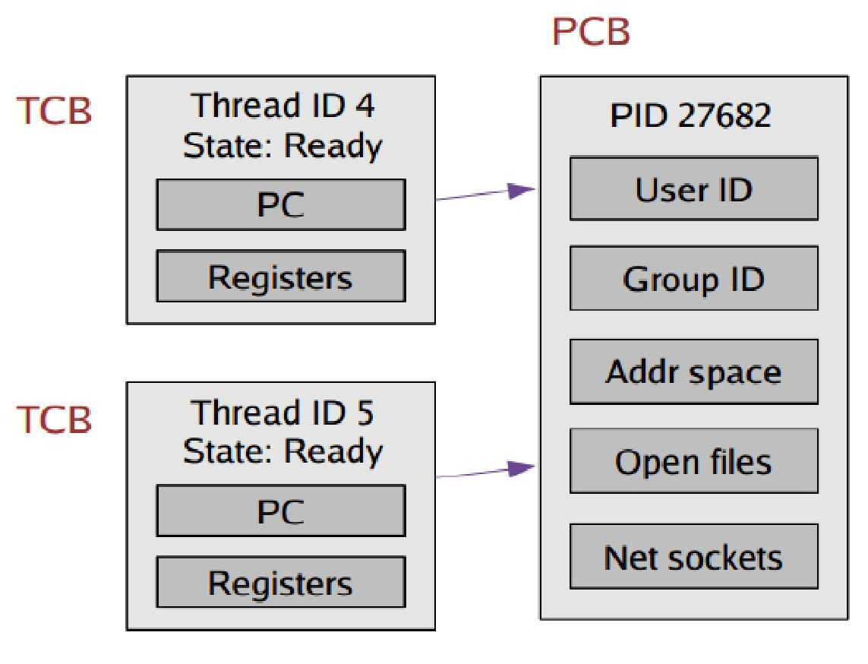
Thread Control Block (TCB)
Break the PCB into two pieces
Info on program execution stored in Thread Control Block (TCB)
Program counter
CPU registers
Scheduling information
Pending I/O information
Other infos stored in Process Control Block (PCB)
Memory management information
Accounting information

Slide 27
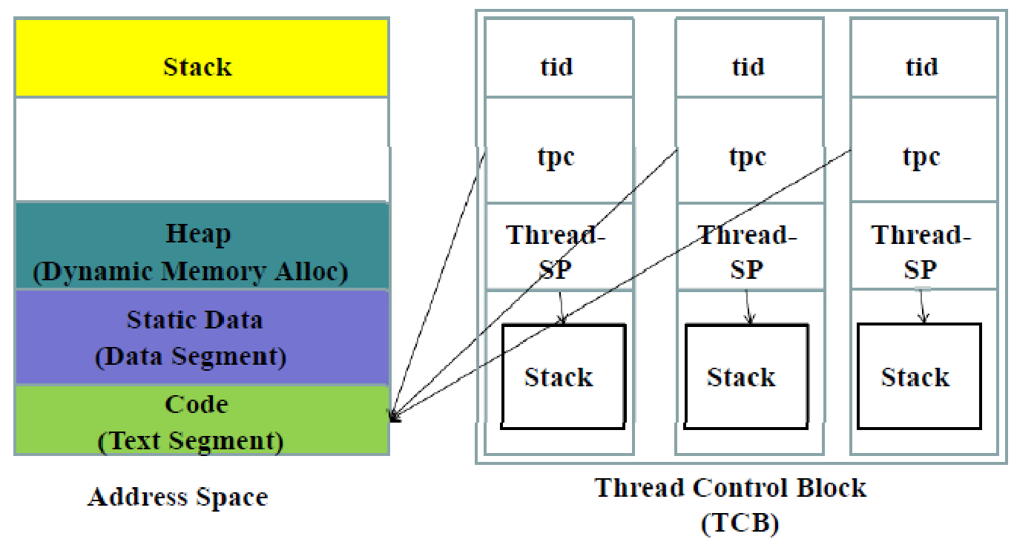
TCB Diagram

Slide 28
Outcome of using TCBs
Threads in a process can execute
Different parts of the program code at the same time
The same parts of the program code at the same time, but with different execution state
They have independent current instructions
They are working with different data

Slide 29
Threading Implementation
Threads in user-space
Threads in kernel-space
Hybrid user/kernel

Slide 30
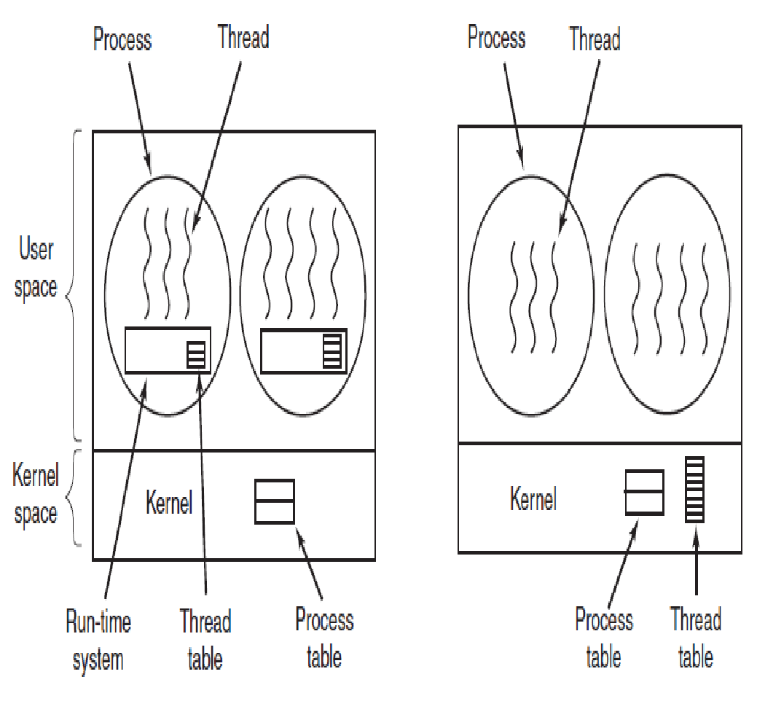
Threads Implemented in User-space
(a) A user-level threads package (MOS Figure 2-16 a)
Notes:
Thread package in user space, including thread table: the kernel know nothing about it
Pthread was implemented in this way

Slide 31
Pros of Threads Implemented in User-space
A user-level threads package can be implemented on an OS that does not support threads
Thread switching is at least an order of magnitude faster, than trapping to the kernel
Thread scheduling very fast: no context switching, no kernel trap, no flushing of memory cache
Each process can have its own scheduling algorithm

Slide 32
Cons of Threads Implemented in User-space
Blocking System calls (e.g., waiting for keyboard input)
Programmers generally want threads precisely in applications where threads block often (Web Server)
Other CPU/OS triggered interrupts
For example, page faults (partial load of programs into memory)
Threads need to voluntarily give up the CPU for multiprogramming
Doesn’t really support real parallelism
Multicore/multiprocessor systems
Notes:
If you do a blocking system call you are stopping all threads – so you have to use all non-blocking system calls
Same as above with the page fault

Slide 33
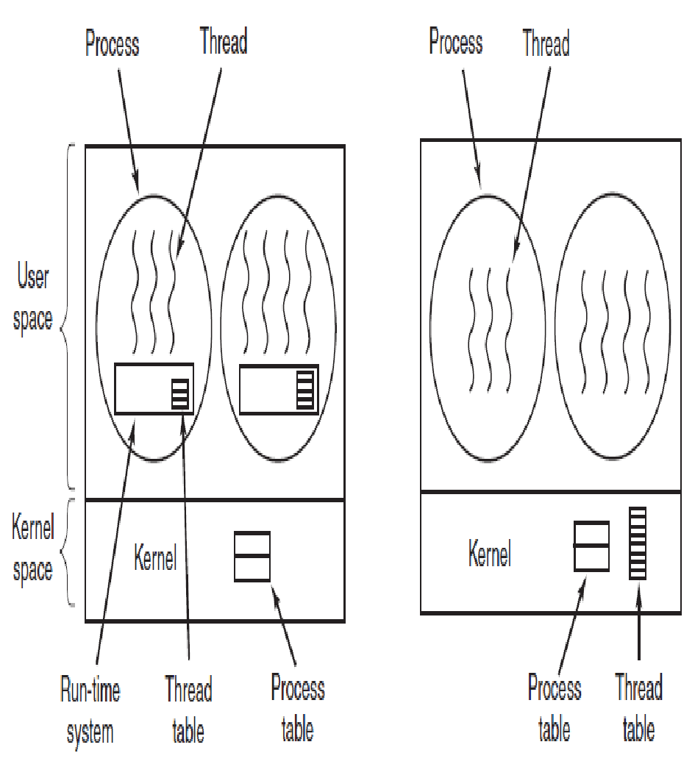
Threads Implemented in Kernel-space
(b) A threads package managed by the kernel. (MOS Figure 2-16 b)

Slide 34
Pros of Threads Implemented in Kernel-space
No run-time system needed in each process
No thread table in each process
Blocking system calls are not a problem
The kernel scheduler can schedule another thread
Supports real parallelism
Multicore/multiprocessor systems

Slide 35
Cons of Threads Implemented in Kernel-space
If thread operations are common (creation, termination), much more kernel overhead will be incurred
Slower than user-space threads
Open problems
Fork a multithreaded process?
Signals sent to processes
Should the kernel assign it to a specific thread to handle?

Slide 36
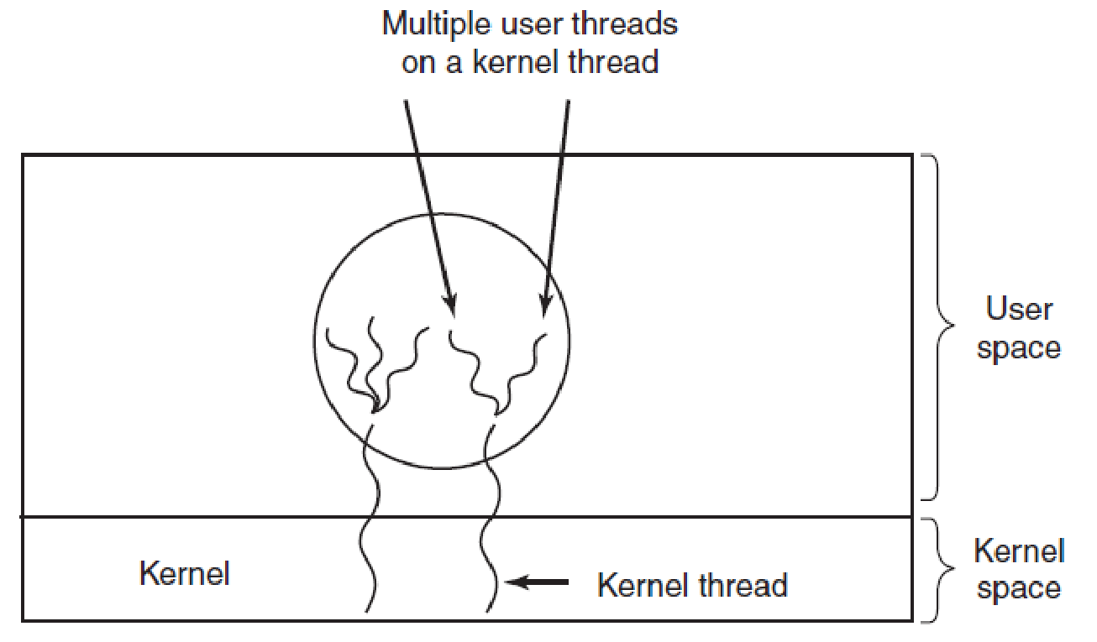
Hybrid Implementations
Multiplexing user-level threads onto kernel-level threads. (MOS Figure 2-17)

Slide 37
Question?
What is the biggest advantage of implementing threads in user-space? What is the biggest disadvantage?
In a system with threads, is there one stack per thread or one stack per process when user-level threads are used? What about when kernel-level threads are used? Explain.

Slide 38
Thread Switching

Slide 39
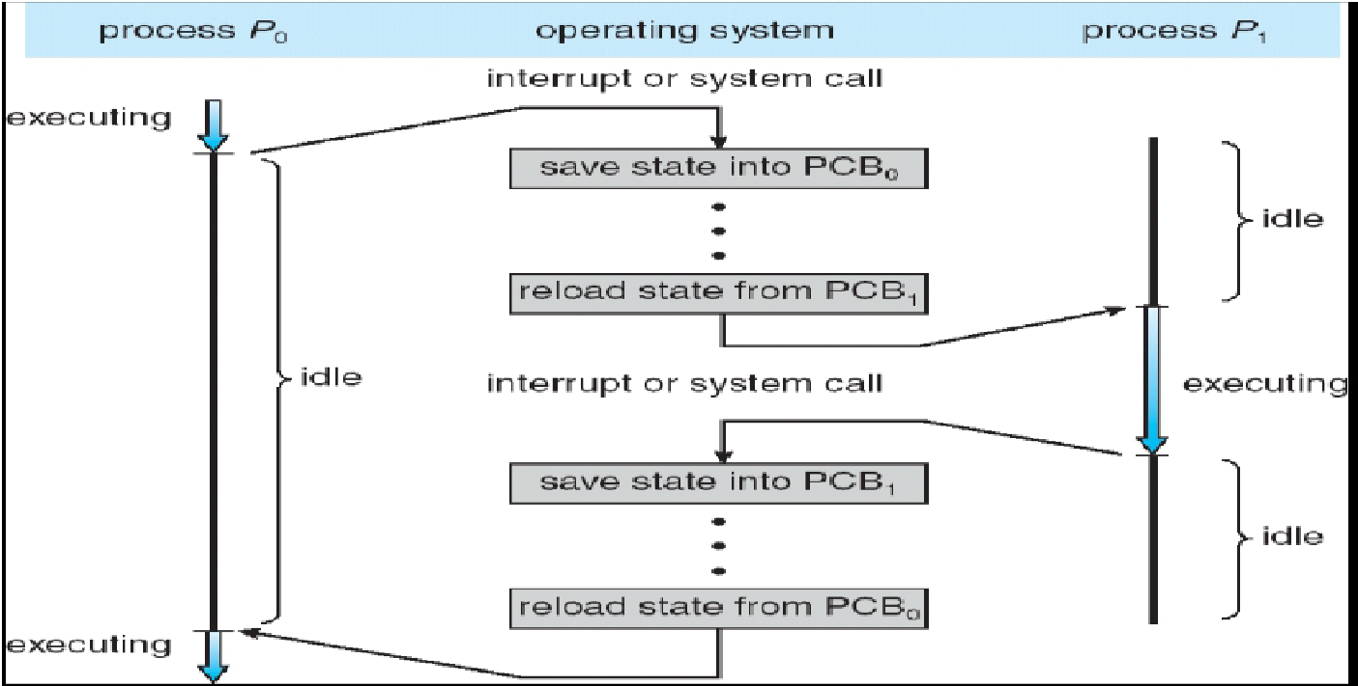
Recall: Process Switch

Slide 40
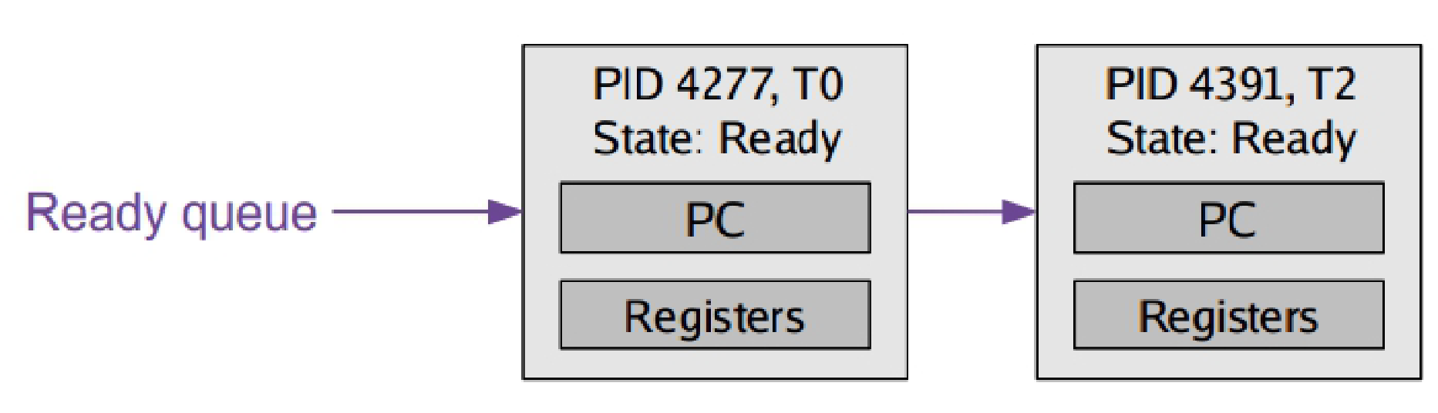
Context Switching Threads (1)
Thread is now the unit of a context switch
Scheduler queues now contain pointers to TCB's
Context switch causes CPU state to be copied to/from the TCB

Slide 41
Context Switching Threads (2)
Context switch two threads of the same process
No need to change address space
Context switch two threads in different processes
Must change address space
Sometimes invalidating cache

Slide 42
Making Single-Threaded Code Multi-threaded

Slide 43
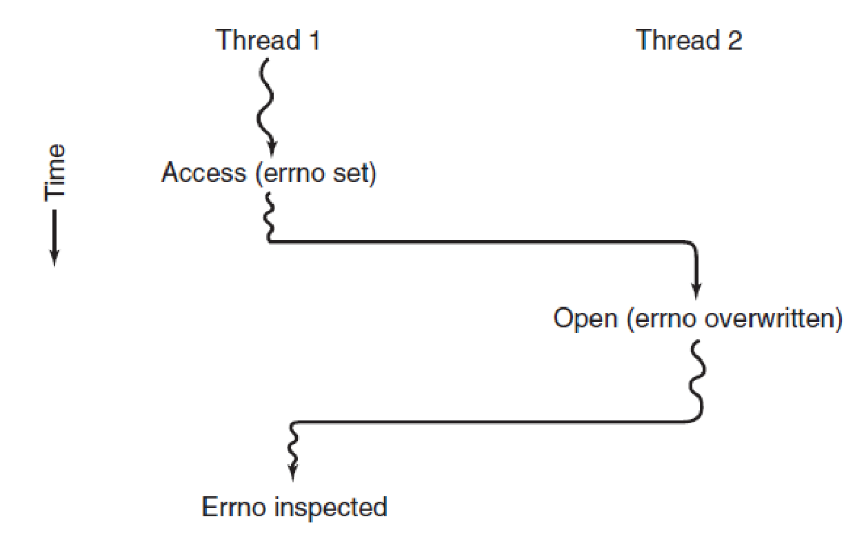
Making Single-Threaded Code Multi-Threaded (1)
Conflicts between threads over the use of a global variable. (MOS Figure 2-19)

Slide 44
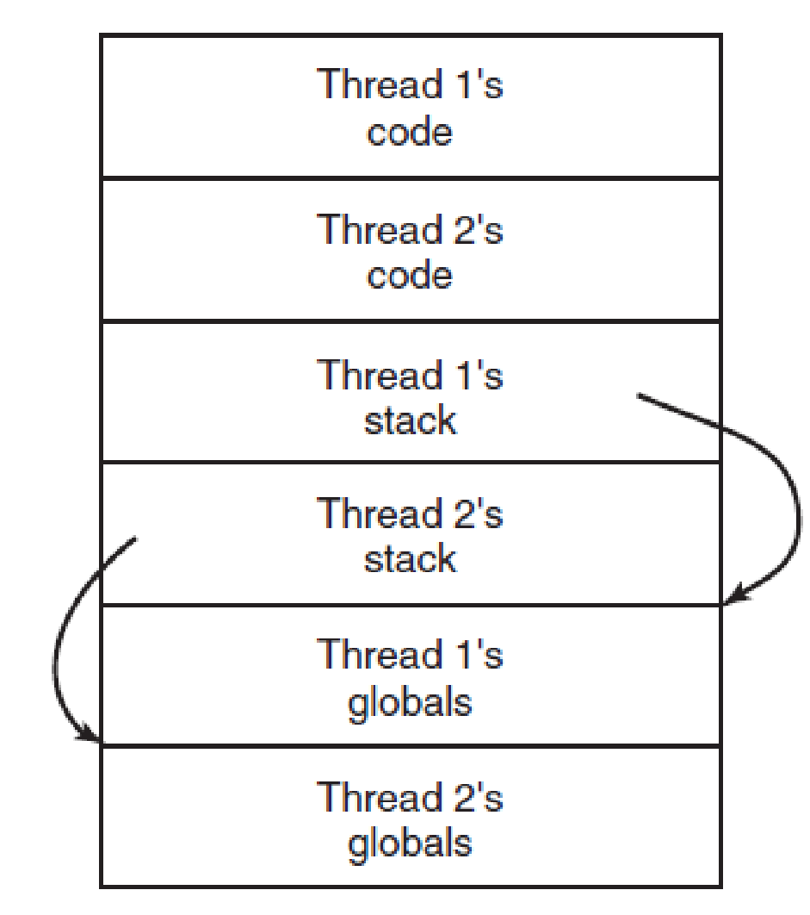
Making Single-Threaded Code Multi-Threaded (2)
Avoid global variables
Or each thread should have its own global variables
Threads can have private global variables. (MOS Figure 2-20)
Notes:
Each thread its own private version of errno

Slide 45
Making Single-Threaded Code Multi-Threaded (3)
Thread-private globals
Using Thread-Local Storage (TLS)
In GCC
__thread int i;
extern __thread struct state s;
static __thread char *p;
In C11
#include <threads.h>
thread_local int foo = 0;

Slide 46
Making Single-Threaded Code Multi-Threaded (4)
Programs may use accessor functions for coordinating creation and access of global variables
create_global(“bufptr”);
set_global(“bufptr”, &buf);
bufptr = read_global(“bufptr”);
Beware: library procedures may not support multi-threading
Reentrant functions support multithreading

Slide 47
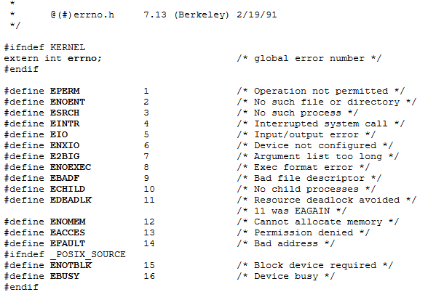
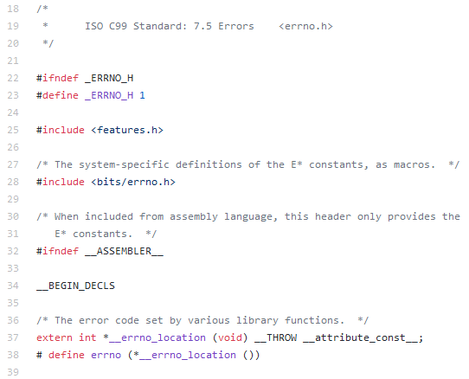
About errno and libc’s functions
Today, most functions and variables are per-thread
1991
2018

